Slide 1
Short Term Business and Tourism in Saudi Arabia
Amal M. Almutairy

Slide 2
Agenda
Problem
Data source
Process
Challenges
Future Goal

Slide 3
Tourism and Economic Development in Saudi Arabia
Investment in the tourism sector is a promising solution for two essential Saudi economic problems:
Less diversified economy
Higher rate of unemployment.
Increasing investment in the Saudi tourism sector can have a significant influence on solving these two problems.

Slide 4
Can we predict employment rate based on investments growth?

Slide 5
Data source
The General Authority for Statistics GASTAT
Short Term Business Statistics
Tourism Establishments Survey

Slide 6
Processing & EDA
Drop irrelevant columns, duplicates, and nulls
Data visualization
Feature engineering
Cross validation
Correlation

Slide 7
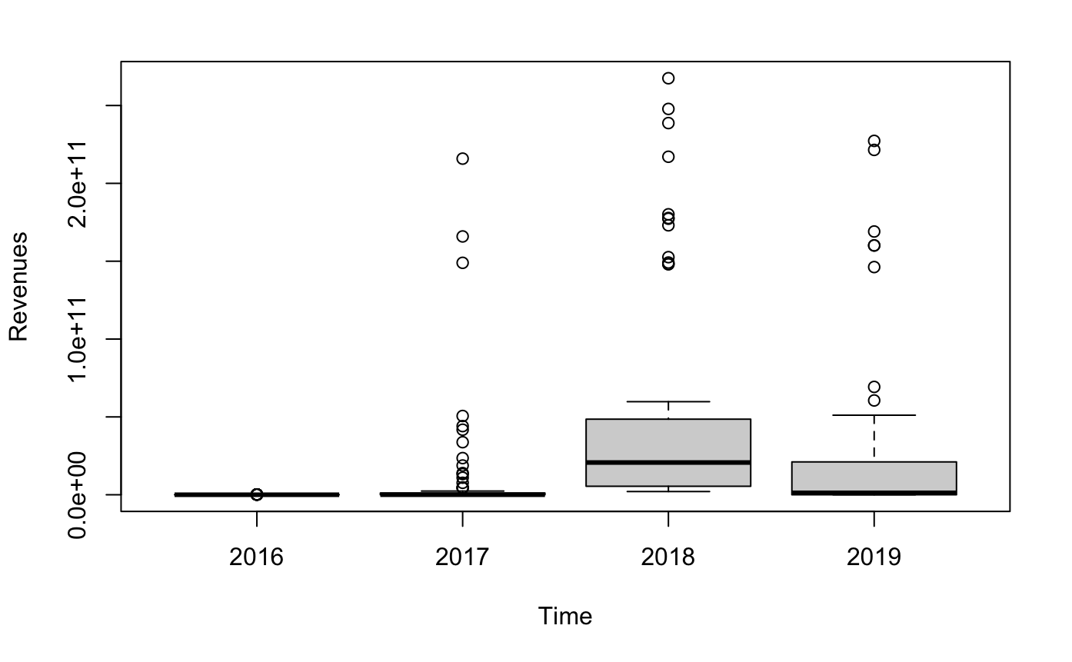
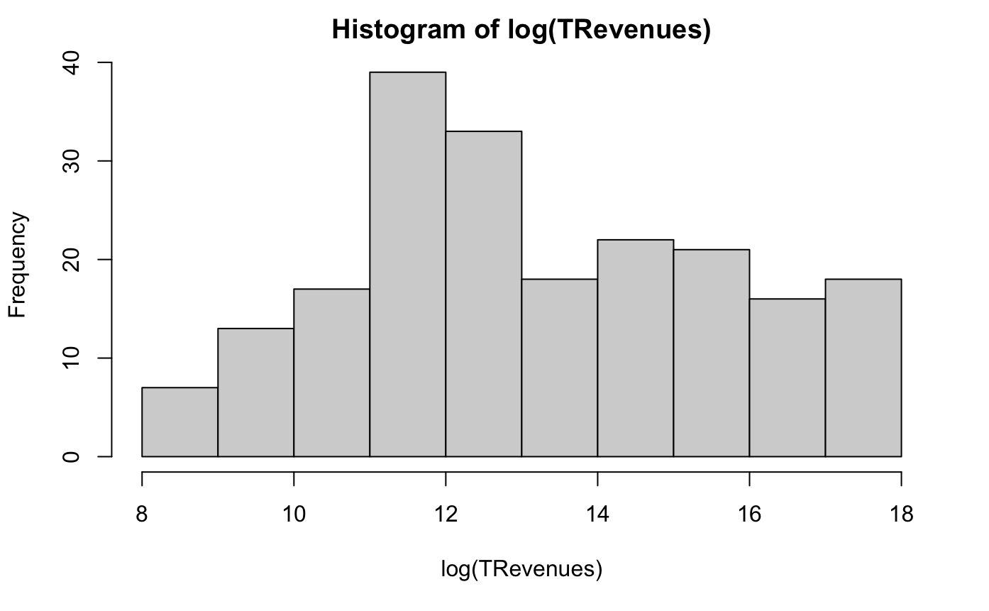

Slide 8
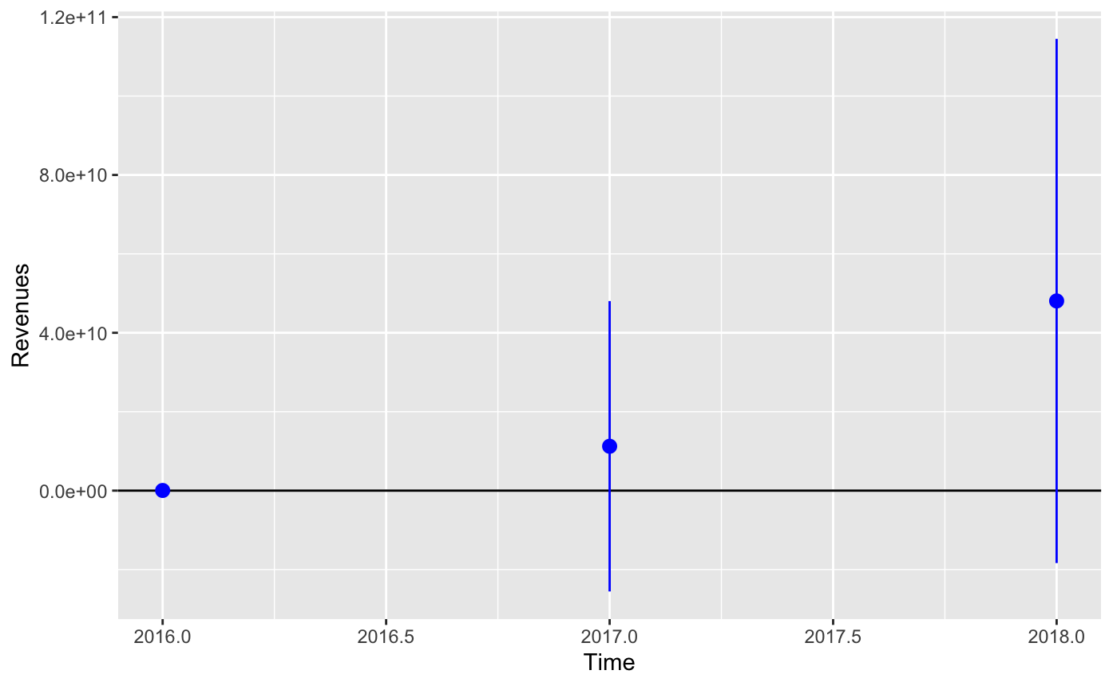
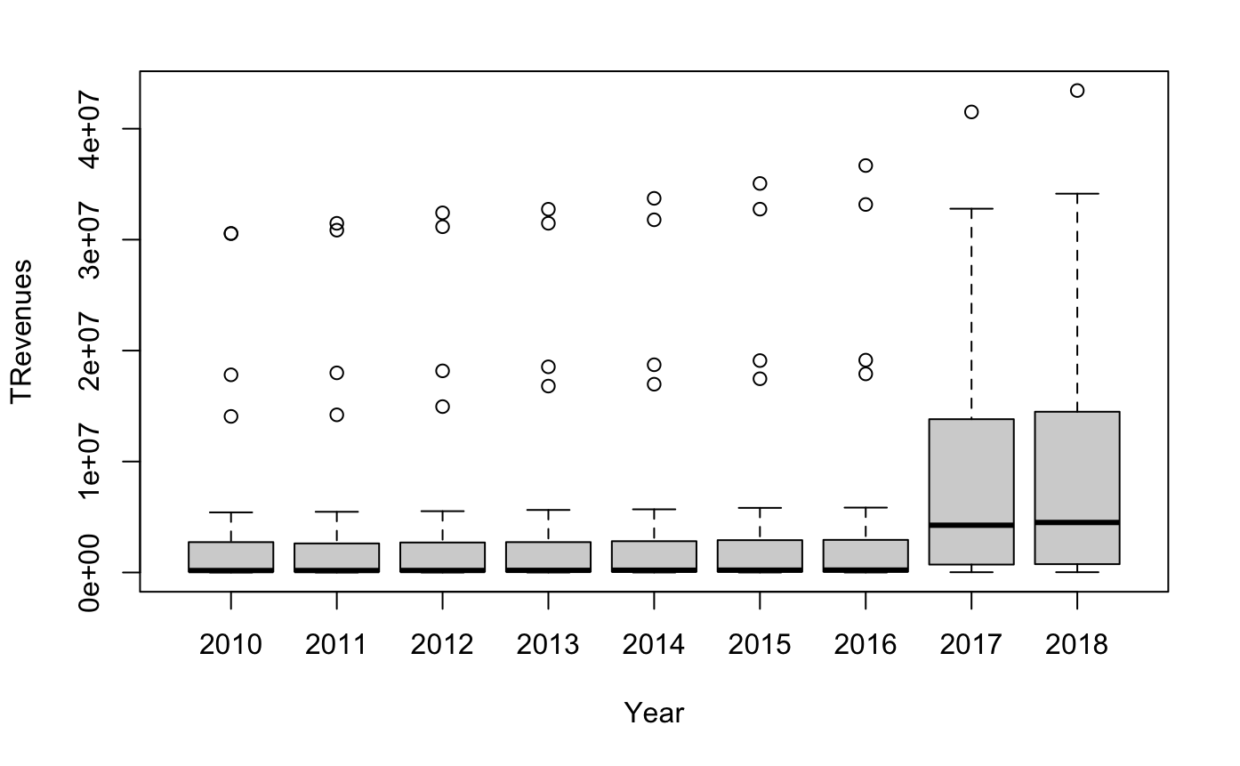

Slide 9
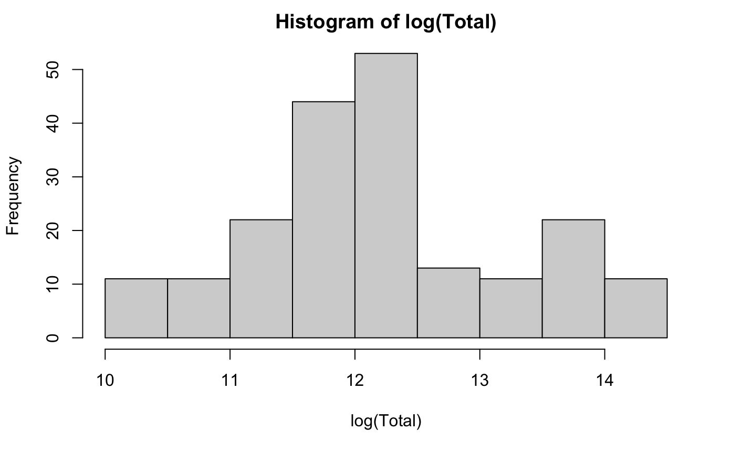

Slide 10
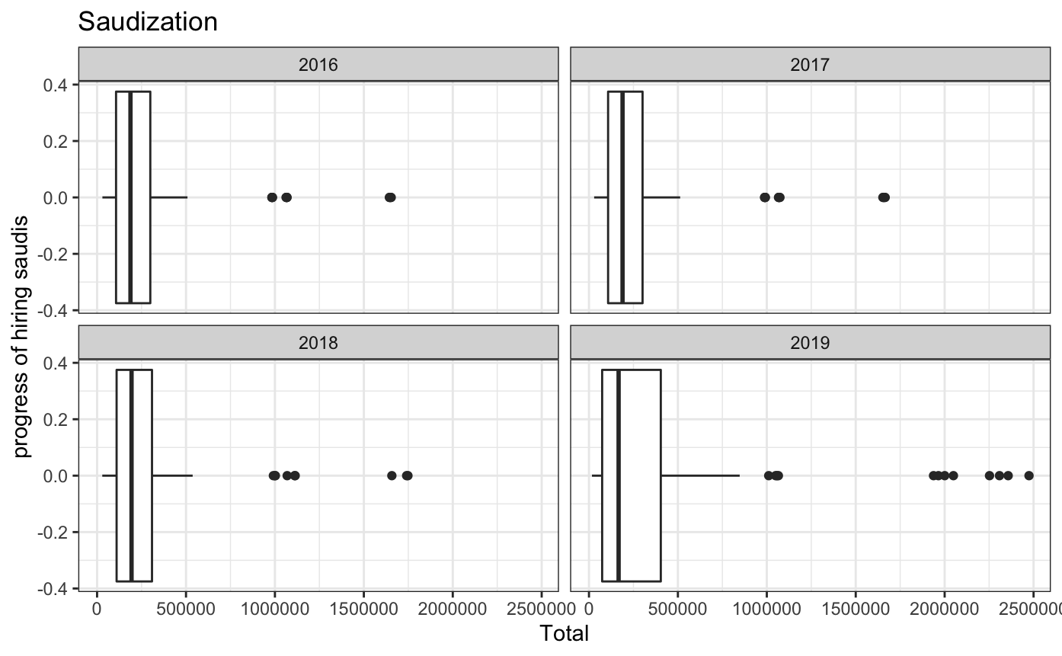

Slide 11
Challenges

Slide 12
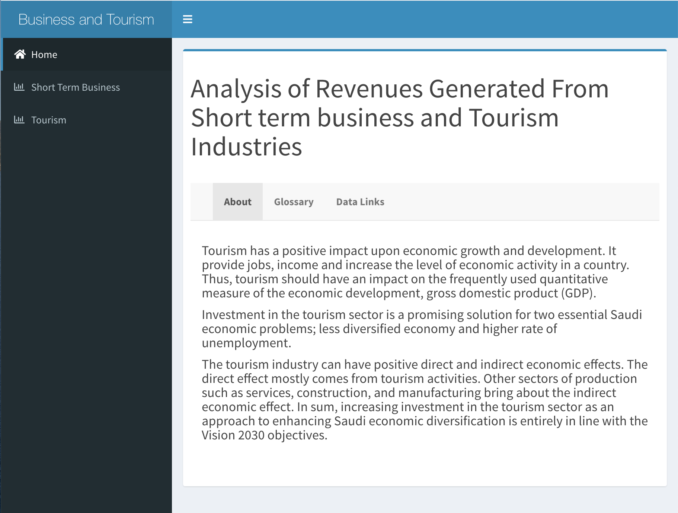
Future Goals:
Complete the app in shiny for predicting the impact of tourism upon economic growth and development.

Slide 13
Thank you

